Slide 1

Comfy Week !
Présente

Slide 2

“A comfortable week with ComfyUI.”
“Une semaine confortable avec ComfyUI.”

Slide 3


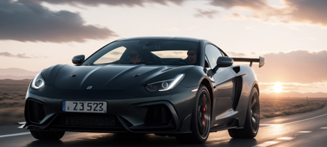
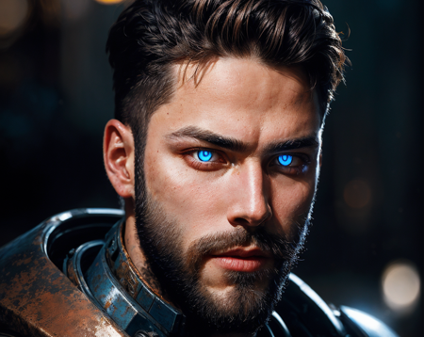

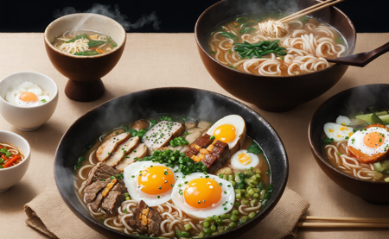

Slide 4







Slide 5
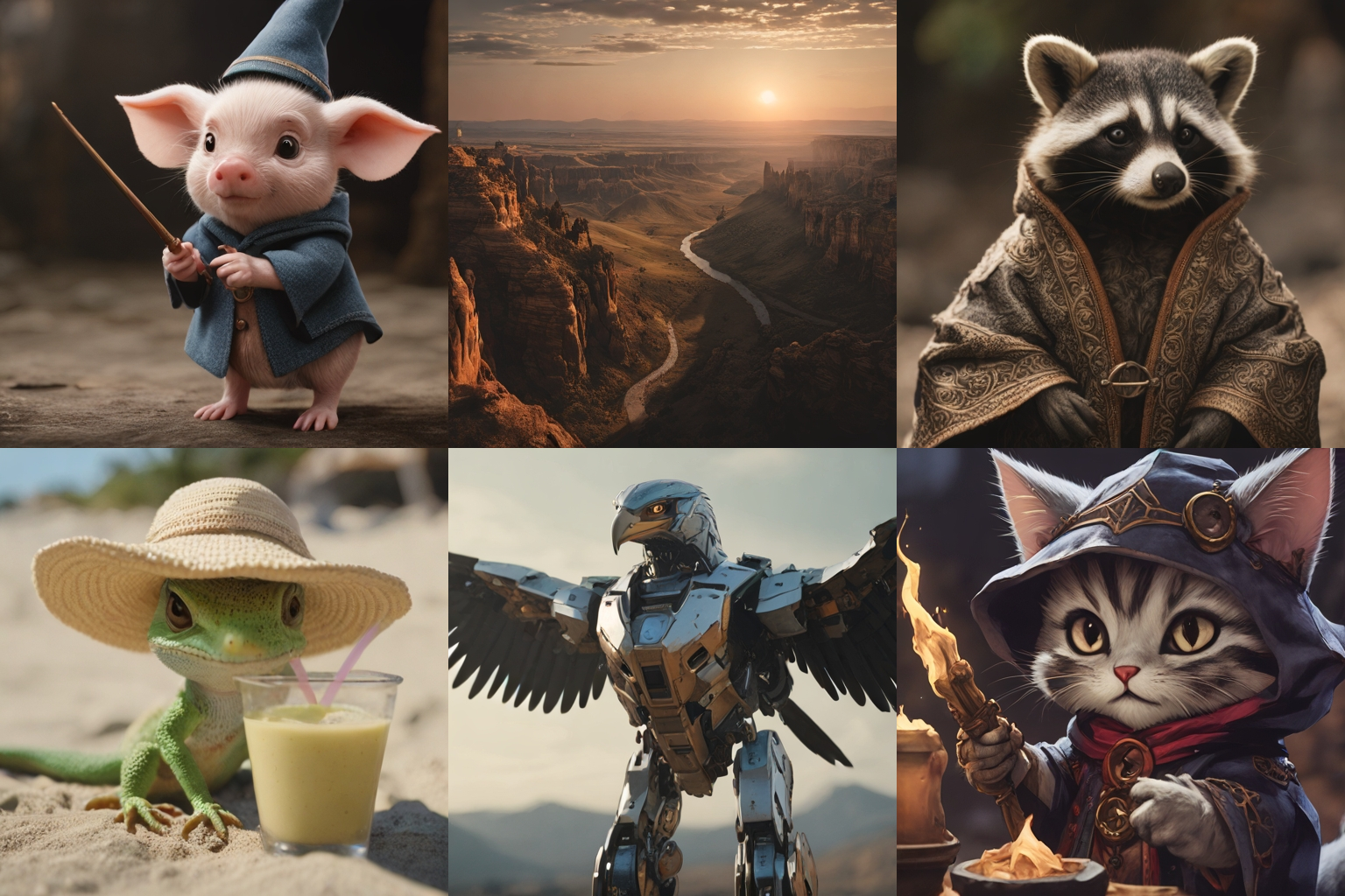
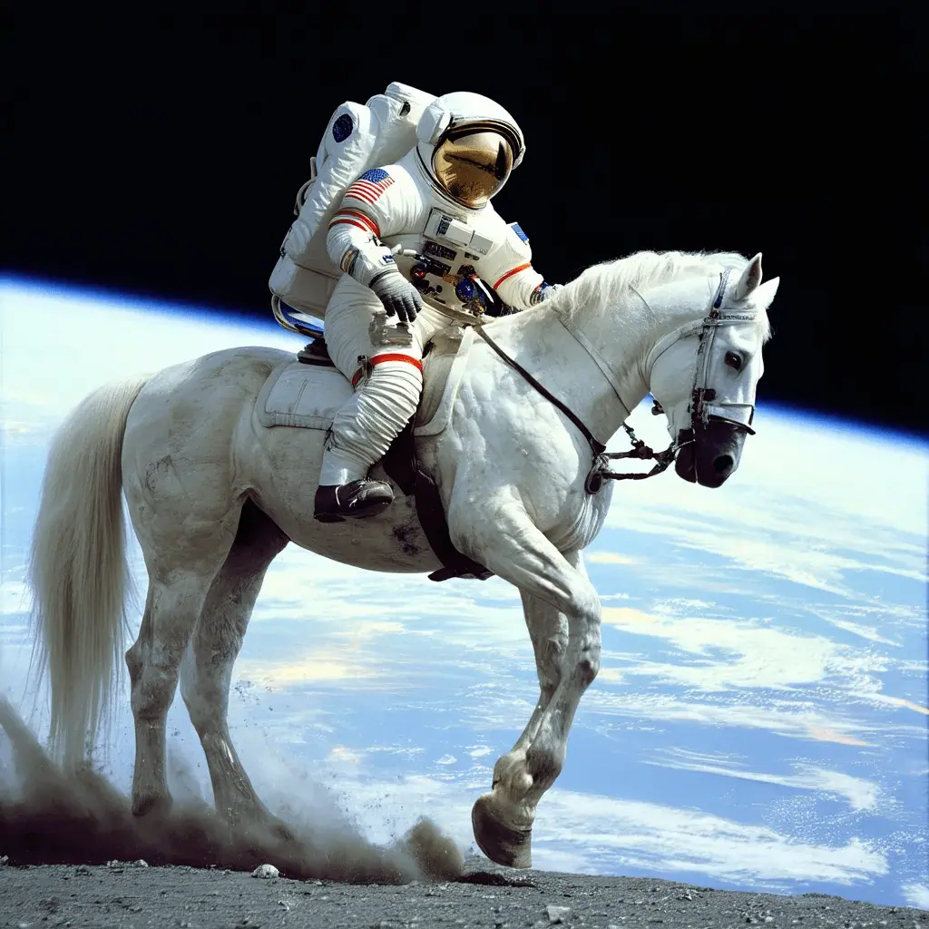



What is stable diffusion?
Stable Diffusion is a text-to-image deep learning model
Code and model weights have been released publicly
Can run on a GPU with 4 GB VRAM (<500$ hardware)
An astronaut
riding a horse

Slide 6
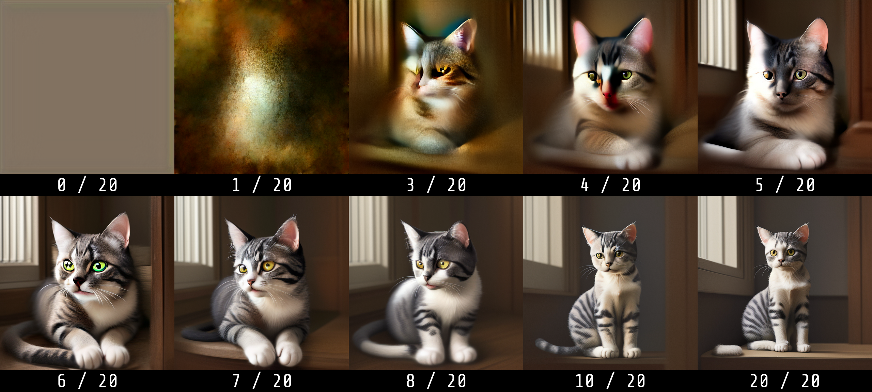
Generation step by step
Prompt: “a cat”

Slide 7

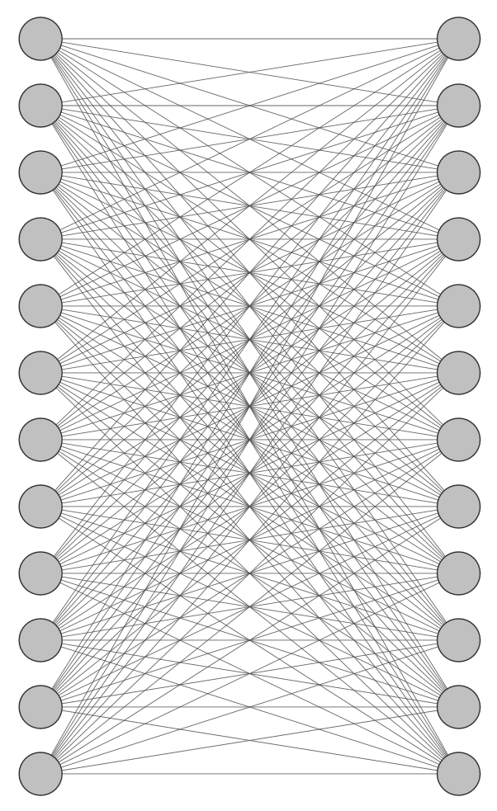
What is a machine learning / artificial intelligence model?
Small network
Big network
+ Low compute cost
- Low “intelligence”
+ High “intelligence”
- High compute cost

Slide 8

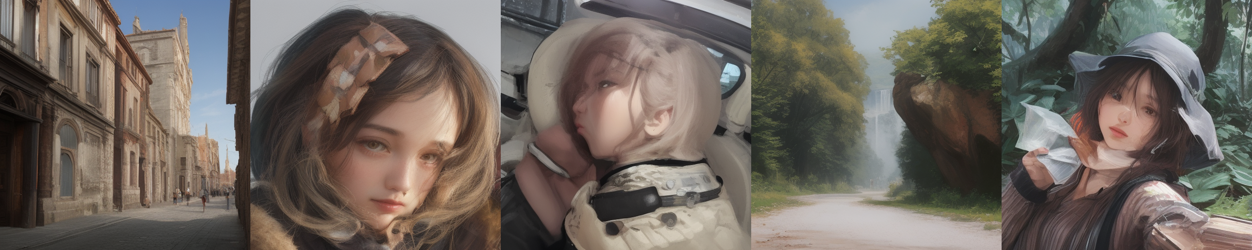
Random images vs Meaningful images

Slide 9
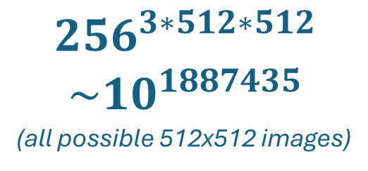
Space of images
$${256}^{3∗512∗512}$$
$$\sim 10^{1887435}$$
(all possible 512x512 images)
“Meaningful” images

Slide 10
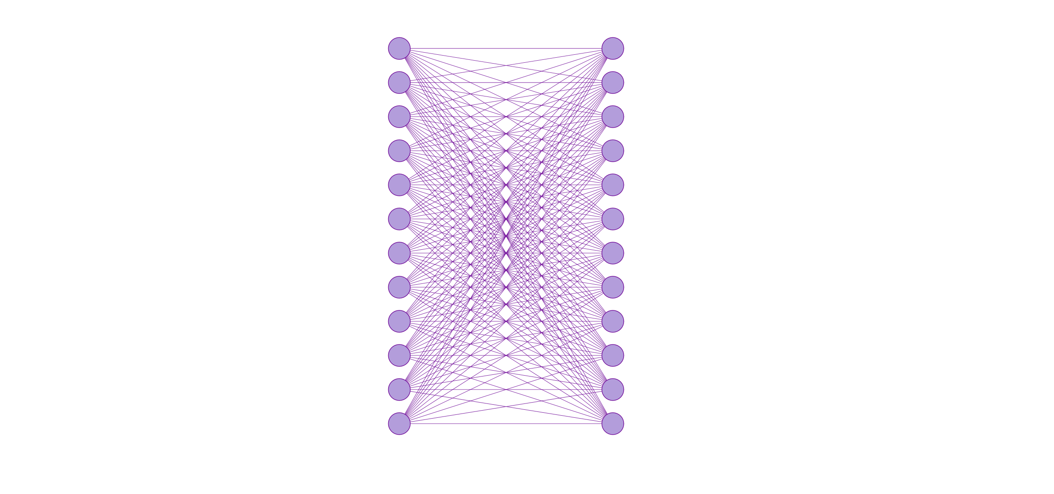

Variational Auto Encoder
VAE
Input image
Output image
Input image
Output image
(encode)
(decode)
Image-space network
Latent-space network

Slide 11
Variational Auto Encoder
(multi-steps)
VAE
Input image
Output image
Input image
(encode)
(decode)
Output image
Image-space network
Latent-space network

